Slide 1
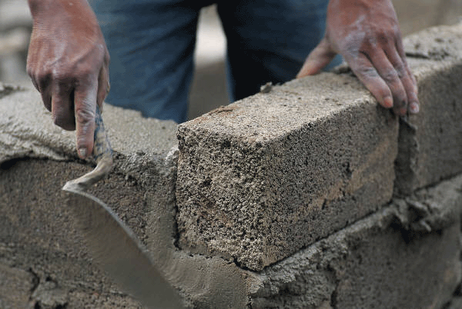
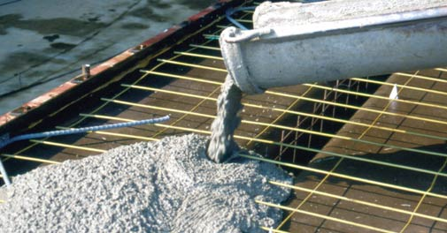
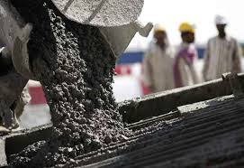
Engineering Materials
Cement

Slide 2
Contents
Introduction
Classification of cements
Portland Cement
Raw materials of Portland cement
Cement Manufacturing Process
Flow chart of Portland Cement manufacturing process
Cement Manufacturing Video
Mixing and Crushing
  Dry Process
  Wet Process
Burning Process
  View of complete setup
  Rotary Klin zones
  Chemical Reactions
Grinding and Packaging
Setting and hardening
  Flow chart
  Sequence
  Chemical Reactions
Special Cement

Slide 3
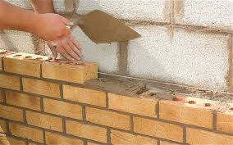
Introduction
“A cement is a binder, a substance that sets and hardens and can bind other materials together. It principal constituents for constructional purpose are compounds of Ca(calcareous) and Al + Si (argillaceous)”
Chemical Composition of Cement
Lime 63%
Silica 22%
Alumina 06%
Iron oxide 03%
Gypsum 01 to 04%
The cements have property of setting and hardening under water, by virtue of certain chemical reaction with it and are called ‘hydraulic cements’

Slide 4
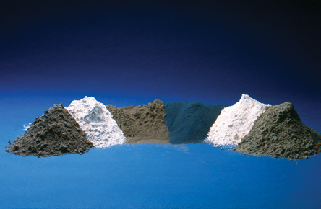
Classification of Cements
Cements
Natural Cement
It is the variety of artificial cement. It is called Portland cement because on hardening (setting) its color resembles to rocks near Portland in England.
Puzzolana Cement
Slag Cement
Portland Cement

Slide 5
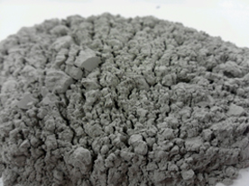
Portland Cement
“An extremely finely ground product by calcinising together , at above 1500ºC , an intimate and properly proportioned mixture of argillaceous (clay) and calcareous (lime) raw materials, without the addition of anything subsequent to calcination , excepting the retarder gypsum”
Clinker | CCN | Mass %
Tricalcium silicate (CaO)₃ · SiO₂ | C₃S | 45–75%
Dicalcium silicate (CaO)₂ · SiO₂ | C₂S | 7–32%
Tricalcium aluminate (CaO)₃ · Al₂O₃ | C₃A | 0–13%
Tetracalcium aluminoferrite (CaO)₄ · Al₂O₃ · Fe₂O₃ | C₄AF | 0–18%
Gypsum CaSO₄ · 2 H₂O |  | 2–10%
Calcium Oxide - CaO |  | 2%
Magnesium Oxide - MgO |  | 4%
Pile of Portland cement
Chemical Composition of Portland Cement

Slide 6
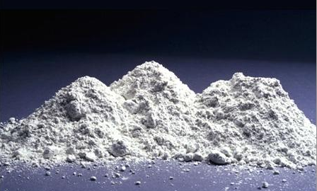
Raw materials of Portland Cement and it’s use
Calcareous materials, CaO [eg. Limestone ]
Principal Constituent and its proportion can be regulated
Excess of lime reduces the strength and makes the cement expand & disintegrate
Lesser amount of lime also reduces the strength by quick setting
Argillaceous materials, Al₂O₃ and SiO₂ [eg. Clay ]
Imparts strength
Makes quick setting
Excess of alumina weakens the cement
Powdered Coal or fuel oil
For burning
.
Gypsum (CaSO₄ 2H₂O)
Retards and enhances quick setting

Slide 7
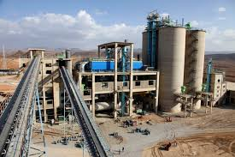
Manufacturing Cement
Mixing and Crushing of raw materials
  Dry process
  Wet process
Burning
Grinding
Storage and Packing

Slide 8
Manufacturing of Portland cement
Agillaceous materials
Callareous materials
A
Rotary Klin
Powdered coal + air
Is Wet process
NO
Crushing & Grinding
Hot Clinkers
YES
Silos
Cooler
Washing
Grinding in Ball Mill
2 -4 % Gypsum
Basin
Storage Silos
Grinding
Water
Packing
Slurry
Correcting Basin
A
Flow Chart of Portland cement manufacturing process

Slide 9
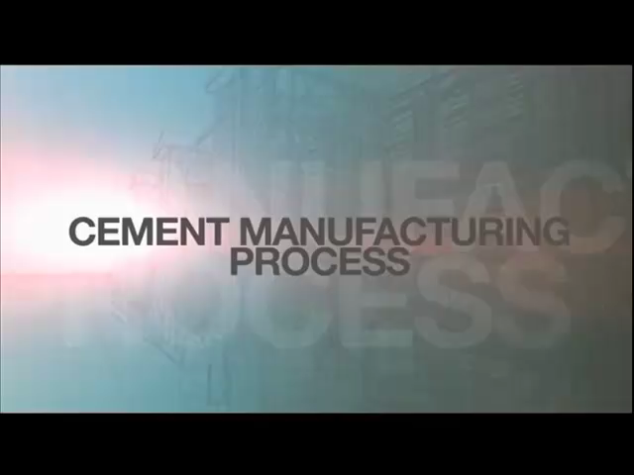
Cement Manufacturing Process : Video

Slide 10
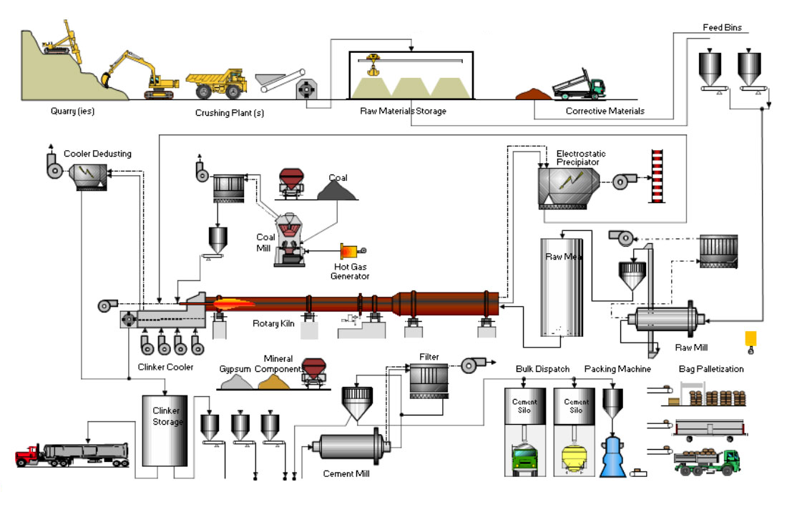
Mixing and Crushing: a) Dry Process
Raw materials are crushed , powdered and mixed in right proportion ( Dry Raw mix )
Stored in silos
1. Mixing
2. Burning
Burning of dry raw mix is carried out in rotary kiln
Klin rotates at speed of 1 RPM and is slightly inclined in position of 5 – 6 º C
Hot clinkers are cooled with atmospheric air and pulverized together with 2-3% of gypsum in ball mills
3. Grinding
4. Storage & Packing

Slide 11
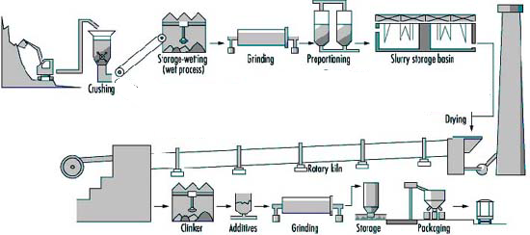
Mixing and Crushing: b) Wet Process
Limestone is crushed, powdered and stored in silos
Clay is washed with water to remove organic matter and stored in basin
Both these materials are mixed in grinding mill to form slurry
Slurry contains 38-40% water stored in correcting basin
Figure showing manufacturing of cement using wet process

Slide 12

Burning Process : View of complete setup
Fig. Rotary Cement Klin
Powdered
Coal
Slurry Tank
5 to 6º inclined refractory-lined rotary kin
Slurry
Hot Air
Air
Blast
Air
Rollers
Hot clinker
Cold
Clinker
Gypsum
Ball
mill
Cement to strong and packing bags

Slide 13
Burning Process : Zones of Rotary Klin
Rotary Klin
Slurry
Drying Zone
Upper part of the kiln
About 400 ⁰C
Most of the water in the slurry gets evaporated
Calcination Zone
Clinkering Zone
400 ºC
700 – 1000ºC
1250 – 1500ºC
90 -120 m
Center part of the kiln
About 700ºC – 1000ºC
Lime gets decomposed into CaO and CO₂
5 to 6 º inclined
Lower part of the kiln
About 1250ºC - 1500ºC
Reacts with clay to form various bouge compounds

Slide 14
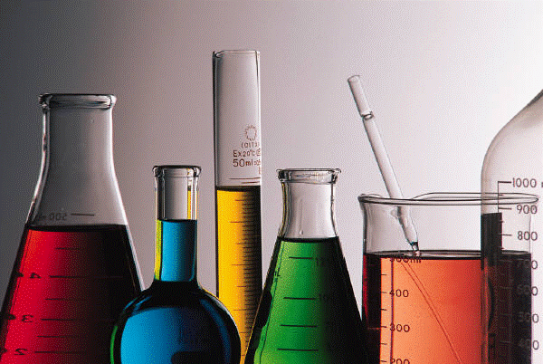
Burning Process : Chemical Reactions in Rotary Klin Zones
Calcination Zone :
CaCO₃ CaO + CO₂
Clinkering Zone :
2CaO + SiO₂ Ca₂SiO₄ ( Dicalcium silicate – C₂S )
3CaO + SiO₂ Ca₃SiO₅ ( Tricalcium silicate – C₃S )
3CaO + Al₂O₃ Ca₃Al₂O₆ ( Tricalcium aluminate – C₃A )
4CaO + Al₂O₃ + Fe₂O₃ Ca₄Al₂Fe₂O₁₀
(Tricalcium aluminoferrite – C₄AF)

Slide 15
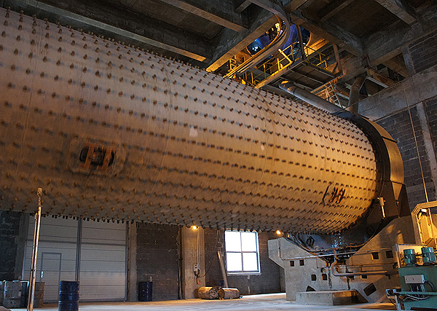
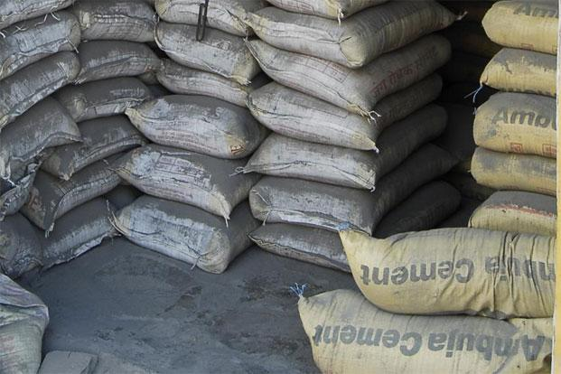
Grinding and Packaging
Grinding
Cooled clinkers are ground to fine powder in ball mills
At final stages of grounding about 2-3% of powdered gypsum is added.
(This is to avoid setting of cement quickly when it comes in contact with water)
Gypsum acts as a retarding agent for early setting of the cement
3CaO + Al₂O₃ + x CaSO₄ . 7H₂O 3CaO . Al₂O₃ . xCaSO_{4 .} 7H₂O
After initial set Gypsum Tricalcium sulphoaluminate (Insoluble)
Packaging
Ground cement is stored in silos
From silos they are automatically packaged into bag which are about 50 Kg

Slide 16
Properties of cement : Setting and hardening
When the cement is mixed with water, hydration and hydrolysis reactions of Bogue compounds of cement begin, resulting in formation of gel and crystalline products.
These products have the ability to surround inert materials liks sand , bricks , crushed stones, etc.
“ Setting is the stiffening of original plastic mass due to the formation of tobermonite gel”. It can be divided into 2 stages a) Initial Set b)Final Set
Initial Set is when paste being to stiffen
Final Set is when the paste beginning to harden and able to sustain some loads
“ Hardening is the development of strength due to formation of crystals”

Slide 17
Setting and hardening
Unhydrated Cement
Hydration
Metastable Gel
Crystalline hydration products
Stable Gel
Crystalline products
Figure showing setting and hardening of cement

Slide 18
Sequence of changes during setting and hardening
Cement
+
Water Paste
1st day
Hydration of C₃A and C₄F
7th day
Gelation of C₃S
28th day
Gelation of C₂S and C₃S

Slide 19
Setting and Hardening : Chemical Reactions
Day 1 :
When cement is mixed with water, hydration of tricalcium aluminate (C₃A) takes place within a day
The paste becomes rigid, which is known as Initial set or Flash set
To avoid early setting of C₃A , gypsum is added which acts as retarding agent
3CaO . Al₂O₃ + 6H₂O 3CaO . Al₂O₃ . 6H₂O + 880 kJ/Kg
Tricalciumaluminate
Hyderated tricalcium aluminate (Crystalline)
[OR]
C₃A + 6H₂O C₃A . 6H₂O + 880 kJ/Kg
C₃A + 3CaSO_{4 .} 2H₂O C₃A . 3CaSO₄ . 2H₂O
Caclium sulpho aluminate

Slide 20
Setting and Hardening : Chemical Reactions contd…
Day – 2 to 7 :
After hydration of C₃A, C₃S beings to hydrate to give tobermonite gel and crystalline Ca(OH)_{2,} which is responsible for initial strength of the cement
The hydration of C₃S gets completed within 7 days
2[3CaO .SiO₂] + 6H₂O 3CaO.2SiO₂ . 3H₂O + 3Ca(OH)₂ + 500 kJ/Kg
Tricalcium silicate
Tobermonite gel Crystalline
[OR]
2C₃S + 6H₂O C₃S_{2 .} 3H₂O + 3Ca(OH)₂ + 500 kJ/Kg
Tobermonite gel possesses a very high surface area and very high adhesive property

Slide 21
Setting and Hardening : Chemical Reactions contd…
Day – 7 to 28 :
Dicalcium silicate (C₂S) reacts with water very slowly and gets completed in 7 to 28 days
Increase of strength is due to formation of tobermonite gel and crystalling Ca(OH)₂ of both C₂S and C₃S
2[2CaO . SiO₂ ] + 4H₂O 3CaO .2SiO₂ . 3H₂O + Ca(OH)₂ + 250 kJ/Kg
2C₂S + 4H₂O C₃S₂ . 3H₂O + Ca(OH)₂ + 250 kJ/Kg
Dicalcium silicate
Tobermonite gel Crystalline
[OR]

Slide 22
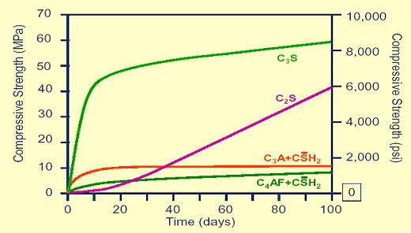
Setting and Hardening : Chemical Reactions contd…
After initial hyderation of tetracalcium alumino ferrite (C₄AF) , hardening takes place through crystallization , along with C₂S
4CaO . Al₂O₃ . Fe₂O₃ + 7H₂O 3CaO . Al₂O₃ . 6H₂O + CaO . Fe₂O₃ . H₂O + 420 kJ/Kg
Tetracalcium alumino ferrite
Crystalline Gel
[OR]
C₄AF + 7H₂O C₃A . 6H₂O
“Hydration and Hydrolysis of Bogue compounds causes cement to develop compressive strength”(Shown in the figure )
Graphical representation of development of compressive strength

Slide 23
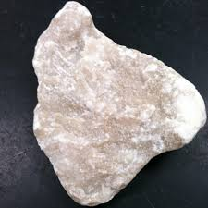
Function of Gypsum (CaSO₄·2H₂O ) in cement
Tricalcium aluminate (C₃A) combines with water very rapidly with the evolution of large amount of heat
After the initial set, the paste becomes stiff.
Adding gypsum retards the dissolution of C₃A by forming insoluble calcium sulpho-aluminate
The above reaction shows how gypsum retards the early initial set of cement
C₃A + 6H₂O C₃A . 6H₂O + Heat
3CaO . Al₂O₃ . xCaSO₄ . 7H₂O

Slide 24
Heat of Hydration of Cement
When cement is mixed with water, hydration , hydrolysis an gelation reaction starts and some heat is liberated
On an average of 500 kJ/Kg of heat is evolved during complete hydration of cement
Bogue Compounds | Heat of hydration (kJ/kg)
C₃A | 880
C₃S | 500
C₄AF | 420
C₂S | 250
Heat of hydration of Bogue compounds

Slide 25
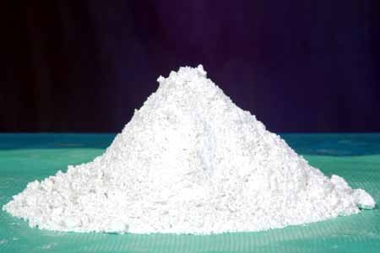
Special Cement : White Portland Cement (or) White cement
Is white in color due to absence of iron compounds
Obtained by calcining the raw materials of Portland cement which are free from iron oxide
Properties
More expensive than ordinary Portland cement
Acts as pore – blocking and water – repelling agent
Repairing and joining marble pillars and blocks
Manufacture of tiles and mosaic walls

Slide 26
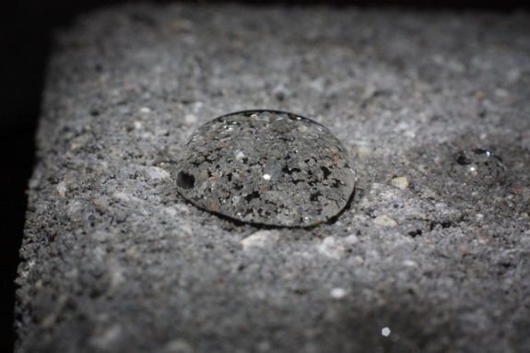
Special Cement : Water proof Cement (or) Hydrophobic cement
Is a cement obtained by adding water proofing substances like calcium stearate, aluminium stearate and gypsum with tannic acid to ordinary Portland cement
Properties
More expensive than ordinary Portland cement
Acts as pore – blocking and water – repelling agent
Used to make concrete which is impervious to water under pressure
Used in construction, where absorption of water need to be avoided
Used in construction of bridges and under water constructions

